Slide 1
Boston vs NYC Rental Markets
Data-driven insights from ~8.7K Boston and ~11.9K NYC listings

Slide 2
How do NYC and Boston compare for renters?
Price: NYC’s median rent is 34% higher, and 1-3BR units are 40-60% pricier than in Boston.
Supply: About 85% of NYC listings are in Manhattan/Brooklyn and over one-third of Boston listings are in Allston/Brighton with 60% sitting in just five neighborhoods.
Affordability: Boston is 3x more affordable than NYC on an $80K salary with a $1.5K rent budget.

Slide 3
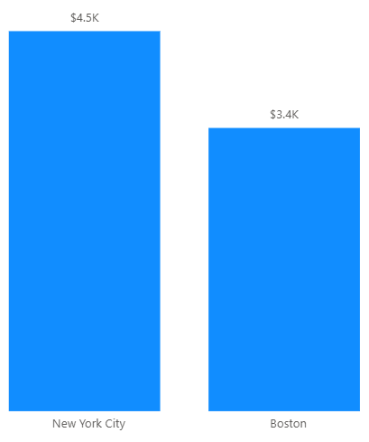
NYC median rent is 34% higher than Boston
The biggest difference renters see when comparing the two cities.

Slide 4
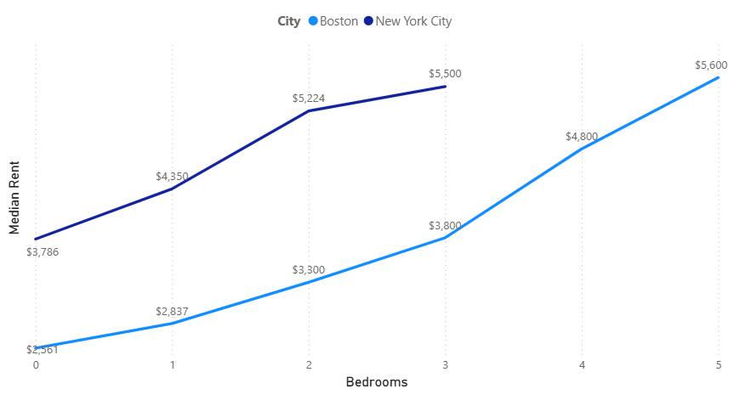
NYC is 40-60% more expensive at every bedroom size
NYC 3BR apartments have a similar median rent as Boston 5BR apartments.

Slide 5
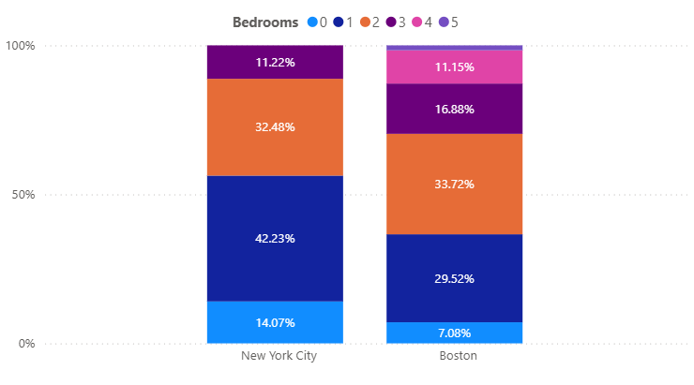
60-75% of listings are 1-2 bedrooms in both cities
Boston has 4-5BR units, unlike NYC which skews toward studios and 1BRs.

Slide 6
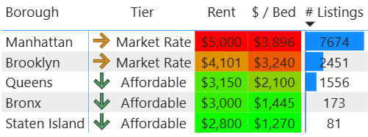
85% of NYC listings are in Manhattan and Brooklyn
Manhattan drives citywide pricing with 63% of listings and a $5K median rent.
Stepping from Queens to Brooklyn to Manhattan adds $1K in median rent.
Queens has the largest affordable supply with 1.5K listings.
Affordable boroughs only account for 15% of all listings.

Slide 7
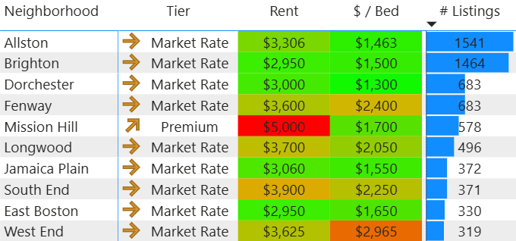
Over 1/3 of Boston listings are in Allston and Brighton; 60% sit in five neighborhoods
Top 10 Neighborhoods by # Listings
Allston and Brighton drive citywide pricing with $3-3.3K median rents and form the city’s largest student housing hub.
Mission Hill has the highest median rent in Boston at $5K, but the lowest price per bedroom among premium areas, consistent with large multi-bedroom units shared by students and hospital staff.

Slide 8
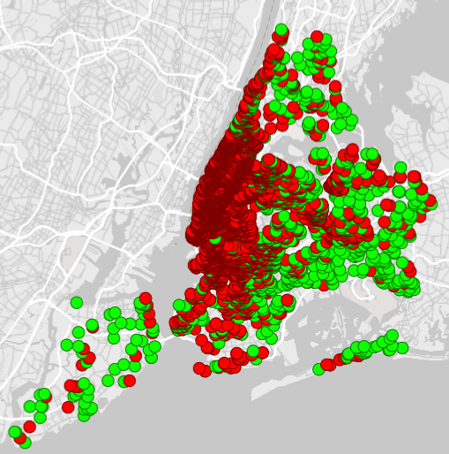
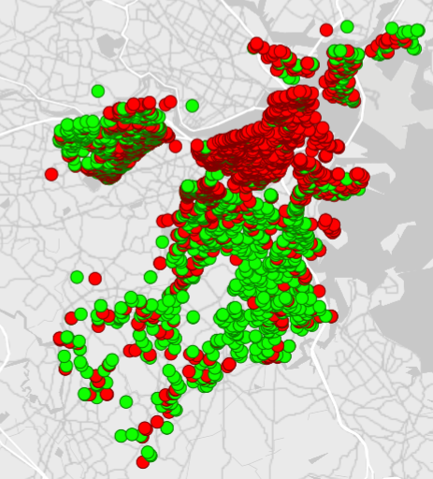
Boston is 3x more affordable on a $1.5K budget
NYC (1,001 Affordable Listings)
Boston (3,092 Affordable Listings)

Slide 9
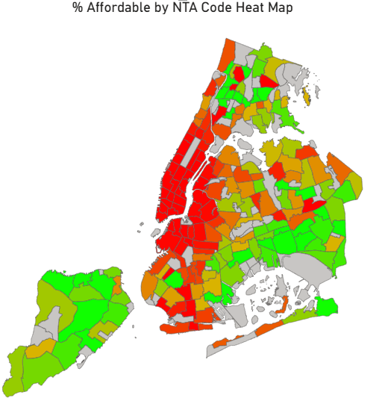
Where can I afford to live on a $1.5K budget in NYC?
Affordable neighborhoods are mostly in the outer boroughs; Queens, Staten Island, and the Bronx.

Slide 10
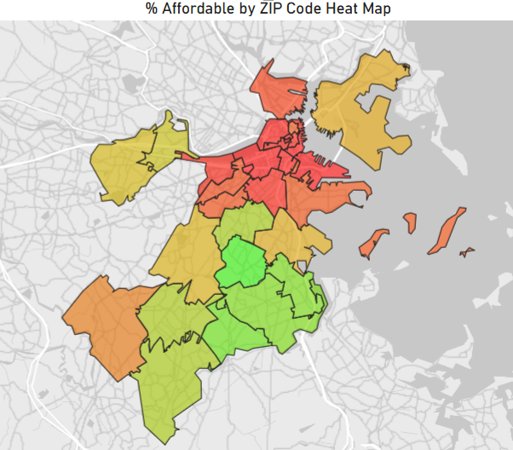
Where can I afford to live on a $1.5K budget in Boston?
Affordable neighborhoods are in Dorchester, Mattapan, Roxbury, Roslindale, and Hyde Park.

Slide 11
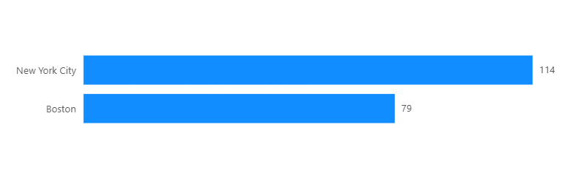
Listings stay active 35 days longer in NYC
Faster turnover speed may suggest more demand in Boston.

Slide 12
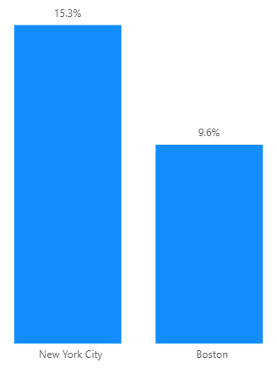
Pet-friendly rentals in NYC have a 60% higher premium per square foot than Boston
For an average 700 sq ft 1BR apartment, that’s roughly $290 vs $460 extra per month.

